Slide 1
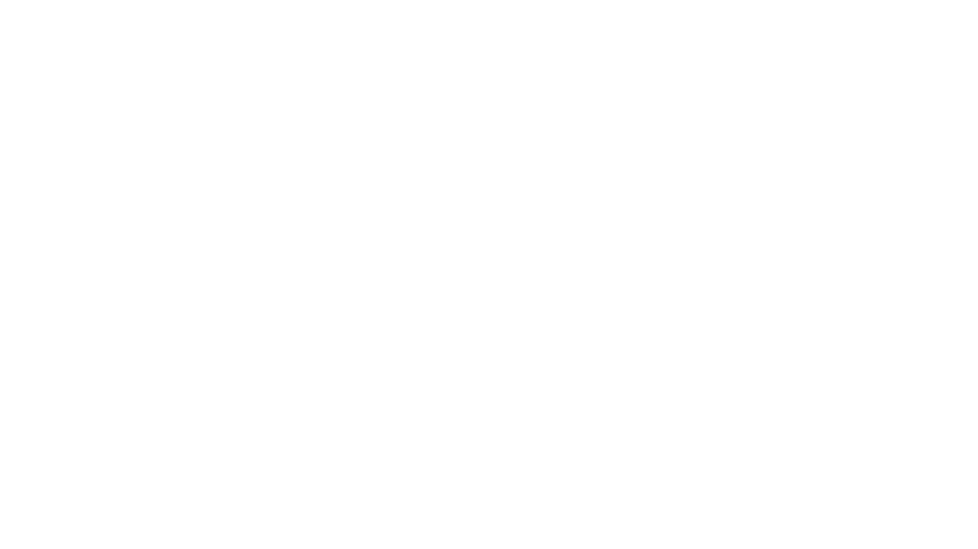
Stream Splitting for moving target defense
Group members: Greg Baltzer, Marvin Roe, Luke Zwenger, Alex Stara
Technical Director: Joshua Lyle - Argonne National Labs

Slide 2
Overview
Project Synopsis
Objectives
Project Methodology
Scope
Principle Outcomes
Demo

Slide 3
Project Synopsis
Stream splitting moving target defense - a method in which data from one host is divided through geographically diverse data streams to its destination.
Never transmits all the pieces of the message on the same link.
Mitigates the risk of a man-in-the-middle attack.
Increases bandwidth by simultaneously using multiple links.
Redundant connections mean more reliable communication in mission-critical environments.
There have been developments in the area of stream splitting but not necessarily for the purpose of moving target defense.
Multipath-TCP (MPTCP)
Equal Cost Multipath Routing (ECMP)

Slide 4
Objectives
Split data streams randomly between data links.
Provide aggregate bandwidth that is equal to the sum of the links’ bandwidth.
Dynamically add and remove data links.
Minimize packet loss on data link failure.
Assure minimal configuration requirements.

Slide 5
Methodology
Incrementally create proof of concept applications.
Build maintainability and scalability throughout the application.
Combine those features into a robust single application.
Measure network performance and error rates to ensure that the added security does not cost in terms of performance.

Slide 6
scope
One of the most important decisions in completing this project was how the scope was going to be defined.
Early on we decided that an application layer solution would be the most feasible.
Based on the skill set of the group we decided that Python would be the ideal language for the application to be written in.

Slide 7
Scope cont.
Based on the initial problem statement from Argonne National Labs (ANL) we generated a list of questions that would help us further hone in the scope of our project.
From these questions we were able to focus on:
The data links will be primarily ethernet and Wi-Fi.
Control of intermediate nodes along the transmission path is not assumed.
Shying away from modifying existing technologies and focusing on the group’s strengths.

Slide 8
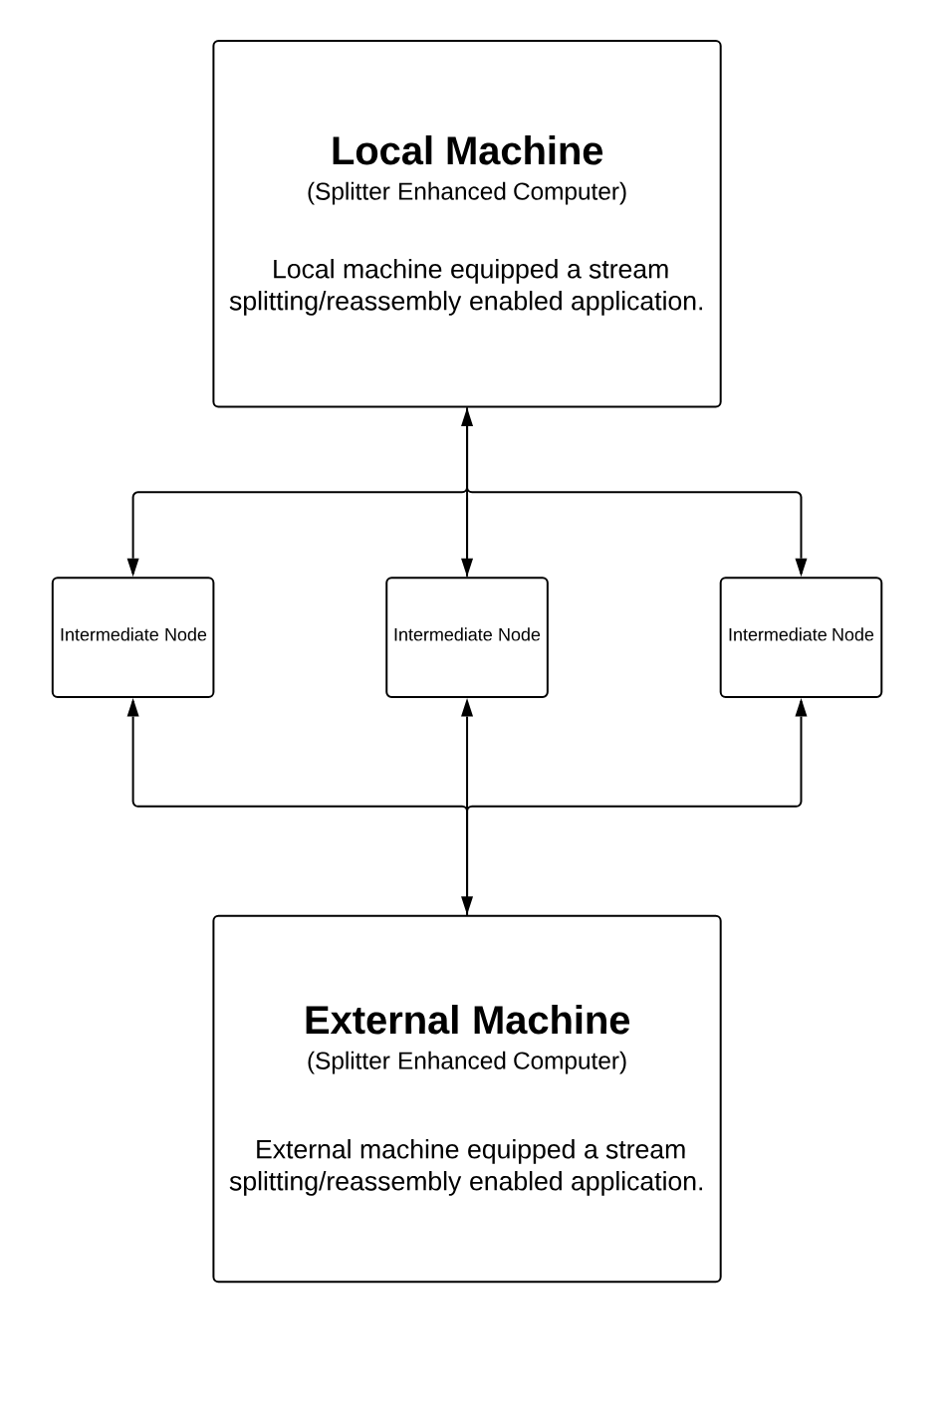
Architectural overview
Level 1 Diagram
At the highest level, we have two machines that are connected to the internet and have intermediate nodes between them.

Slide 9
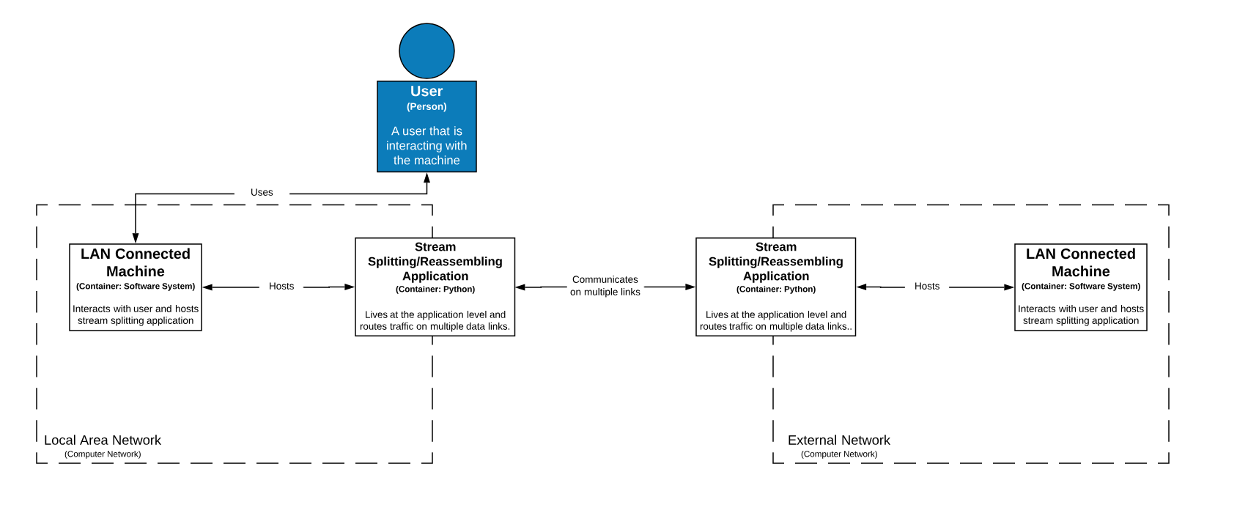
Architectural Overview
Level 2 Diagram
If we dive one level deeper, we see that the stream splitting application actually runs on the host machine that lives inside the network and communicates with the host machine outside the LAN.

Slide 10
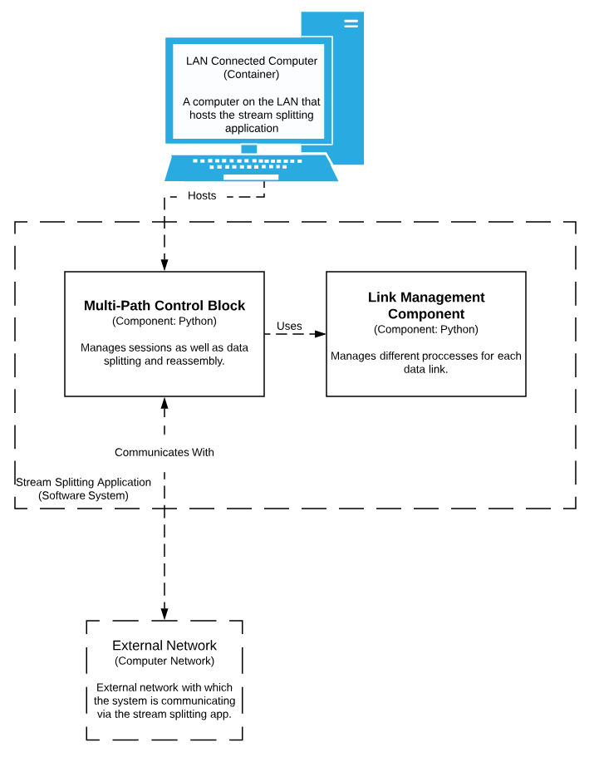
Architectural overview
Level 3 Diagram
One level further we see that the stream splitting application is made up of two major components, the multi-path control block and the link management component.

Slide 11
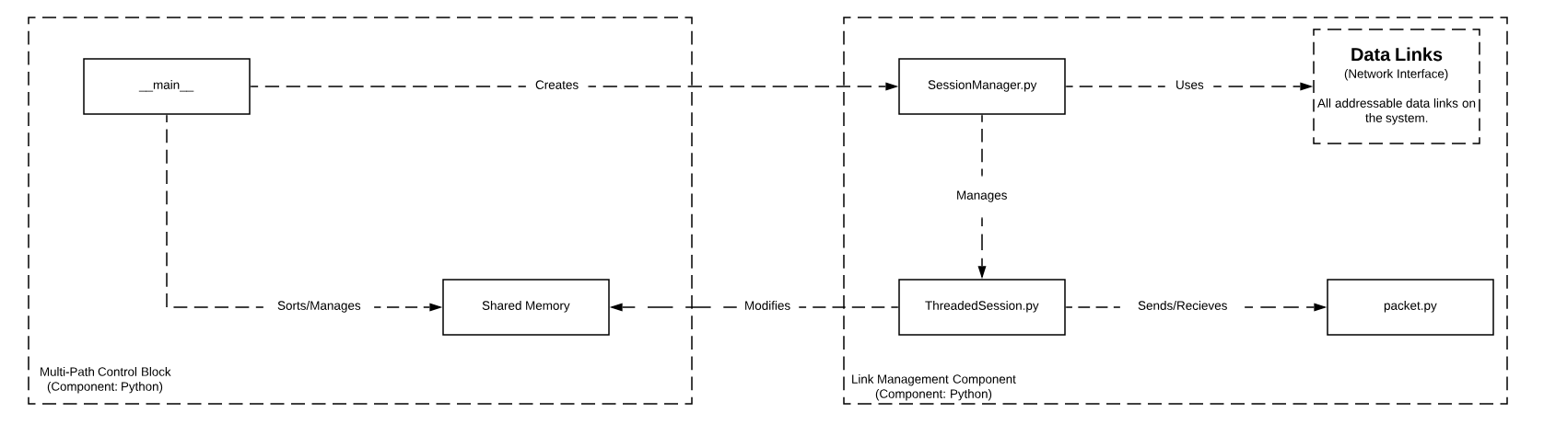
Architectural overview
Level 4 Diagram
At the lowest level we can see that the SessionManager initializes and manages all our connections while the ThreadedSessions receive data and the main function sorts and displays that data.

Slide 12
Outcomes
Keeping all these things in mind, we set out to build a stream splitting application in Python.
We drew inspiration for application features from existing solutions such as Multipath-TCP (MPTCP) , and Equal Cost Multipath Routing (ECMP).
Our first proof of concept application sought to determine if it was possible to connect multiple sockets simultaneously on different interfaces in Python.

Slide 13

Outcomes cont.
The first proof of concept (POC) application was very simple.
The application would enumerate all available network interfaces on the host and it would connect two sockets on a single interface.
It would then transfer data over that interface.
We were fairly confident that this concept would be proven fairly easily and we were correct. Maintaining multiple socket connections, even on different interfaces, was straightforward.

Slide 14
Outcomes Cont.
The second concept we sought to prove was whether or not one could create a thread for each available interface and receive data on all interfaces simultaneously.
This concept was somewhat more intricate to prove. First, each thread would need to be able to receive data simultaneously and then it would have to be able to combine that data from different threads and ensure that data was not overwritten or scrambled in the process.

Slide 15
Outcomes cont.
To create a multithreaded solution, we set up a shared memory space between the threads and implemented a semaphore to prevent thread collision.
We also implemented a packet object that would be the primary data object that we transfer between clients.
Enough talk, let’s have a demo.

Slide 16
Demo

Slide 18
Possible future developments
Load balancing between interfaces.
Optimizing latency by sending data over less congested interfaces.
Dynamic link addition/subtraction.
Adding or removing links as they become available.
Traffic handling for other applications.
Adding the ability for the application to behave almost like a virtual network adapter while still implementing the same stream splitting functionality.

Slide 19
Questions?

